Slide 1
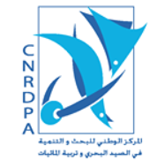

المركز الوطني للبحث و التنمية في الصيد البحري و تربية المائيات
Centre National Center for Research and Development of Fisheries and Aquaculture
EXPERIENCES FROM THE OGS COURSE :
INTRODUCTION COURSE TO MARINE MONITORING HARDWARE AND PROCEDURES
Ahmed INAL
Researcher – CNRDPA
Algeria
SHAREMED International Workshop
Connecting marine research and boosting benefits to society
September 13 - September 14
db San Antonio Hotel & SpA (Malta)

Slide 2
MAIN SUBJECTS ADRESSED
Marine Observations: why, where, when and for what
European Initiatives: Coastal and Open Sea Infrastructures
Introduction to Argo monitoring system
Argo: data download from Coriolis web site and visualization using ocean data view application
Instruments overview and SBE software processing
Best Practices: transmission, download and data processing
Data acquisition, time series analysis: sampling interval and accuracy. quality control application

Slide 3
The Marine Metrology and Calibration Unit (CTMO)
Short presentation of the National Oceanographic Data Centre (NODC) and the European Marine Observation and Data Network (EMODnet): Hands-on Practice with web ODV
Current measurements. single point and doppler systems: principles of operation and applications
Surface current mapping with High Frequency RADAR
Meteorological measurements

Slide 4
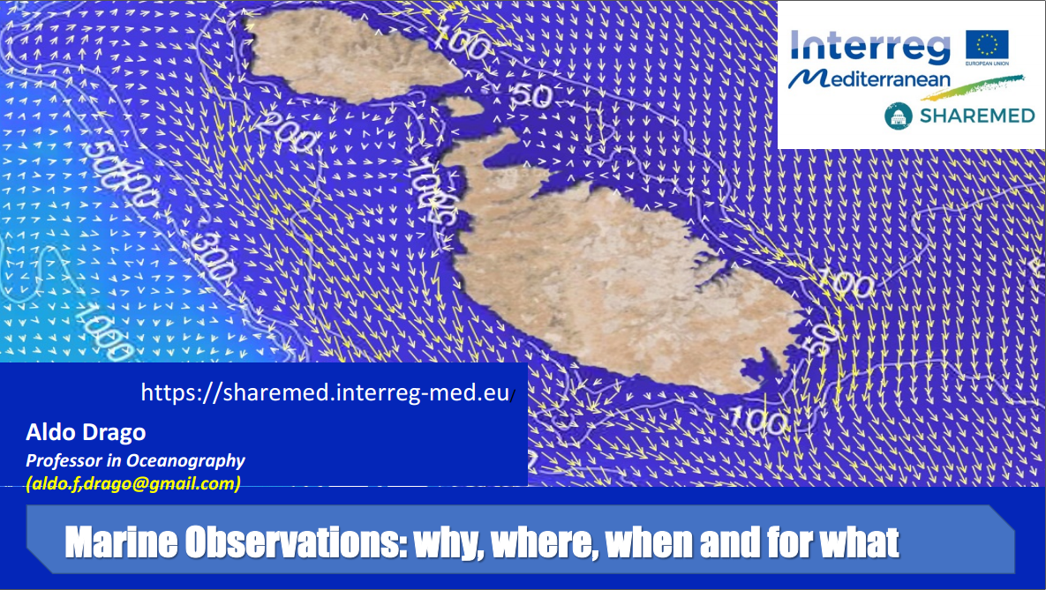
Course introduction
Importance of Ocean Observation
MED Programme Strategic Project SHAREMED consortium
Challenge, Objective and How
European infrastructures for Ocean Observation
– Ocean Decade programs
– MonGOOS Network

Slide 5
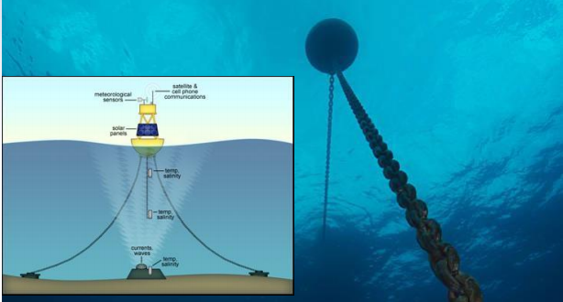
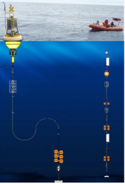
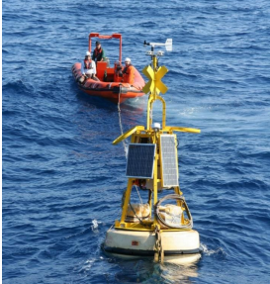
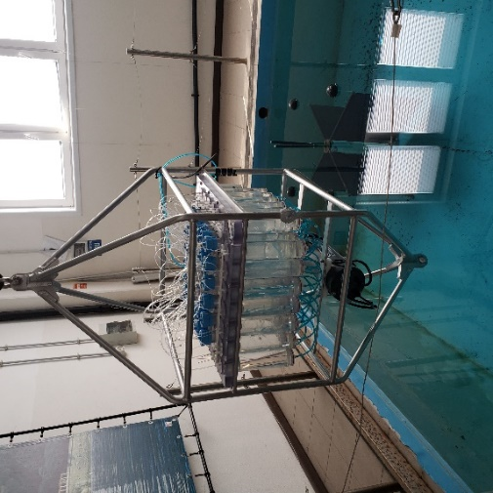
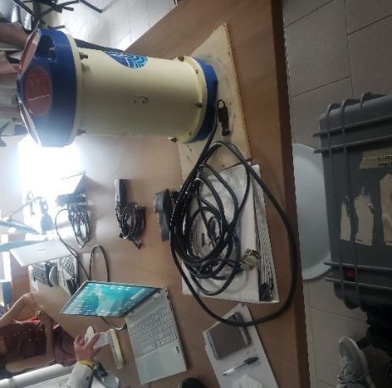
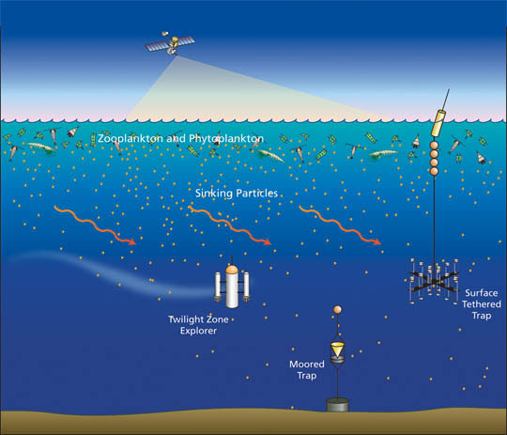
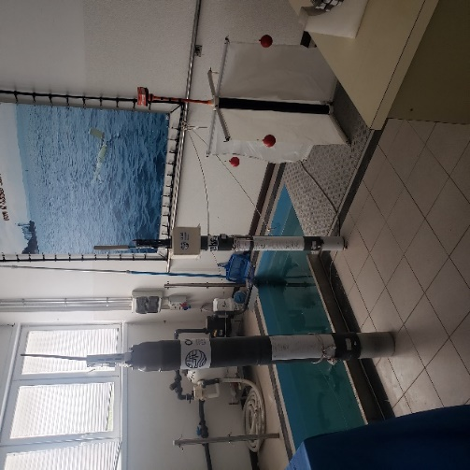
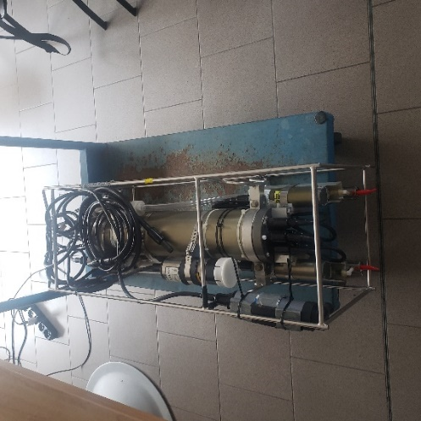
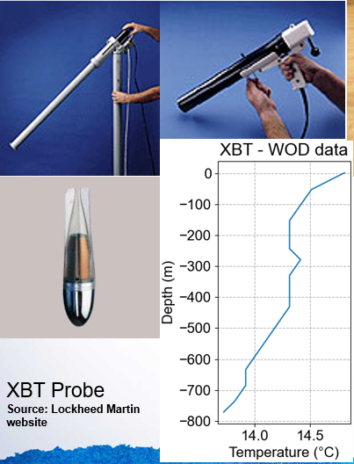
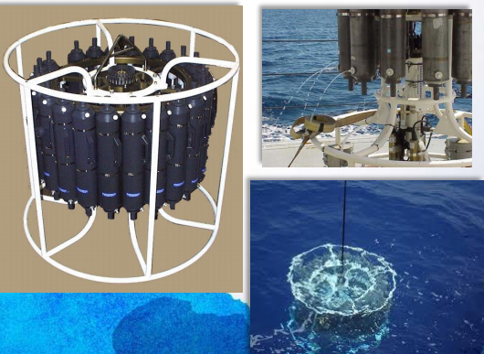
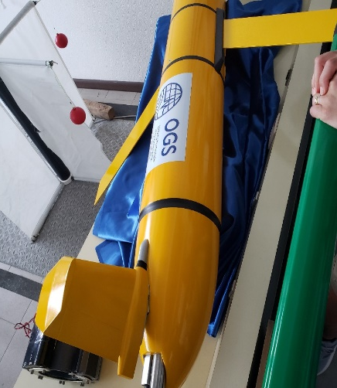
Oceanographic measurement and sampling instruments
Remote Access Sampler (RAS)
Sediment Traps

Slide 6
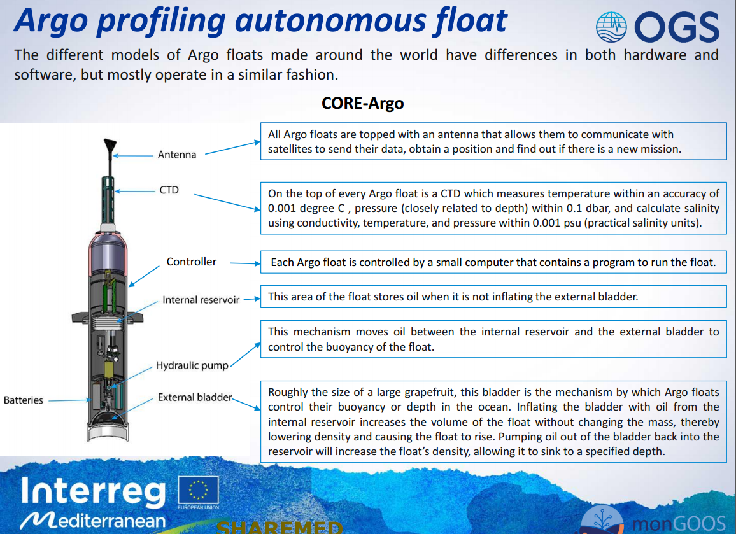
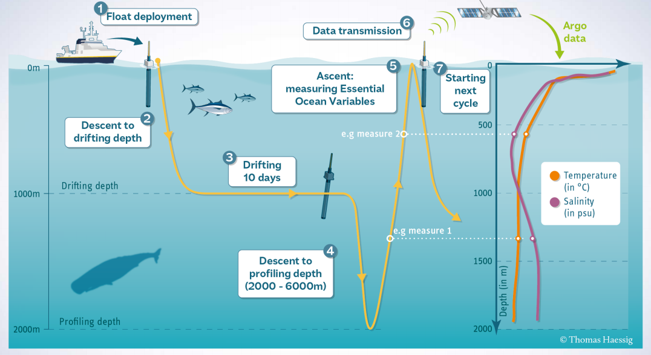
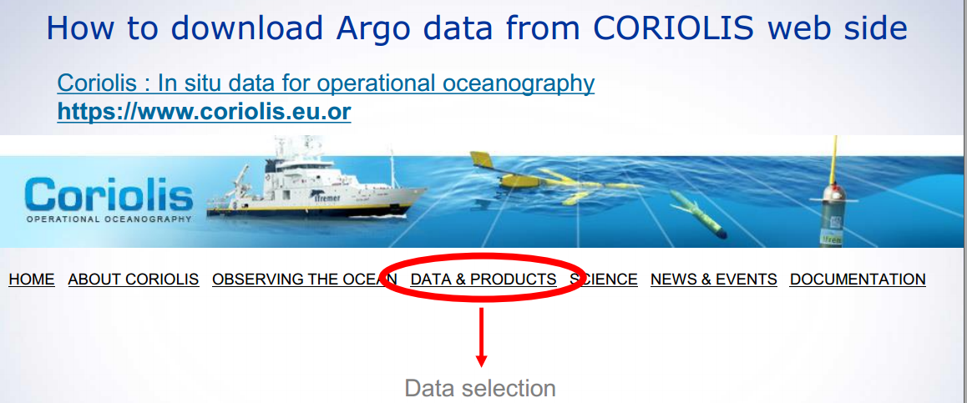
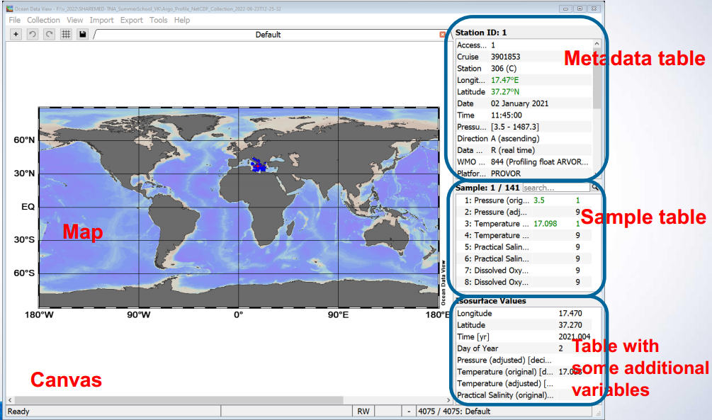
Argo
Introduction to Argo monitoring system
Argo: data download from Coriolis web site and visualization using ocean data view application
- How to download Argo data from CORIOLIS web site
- How to import Argo data into the ODV
- How to plot basic plots in the ODV: T/S scatter plots, vertical profiles,

Slide 7
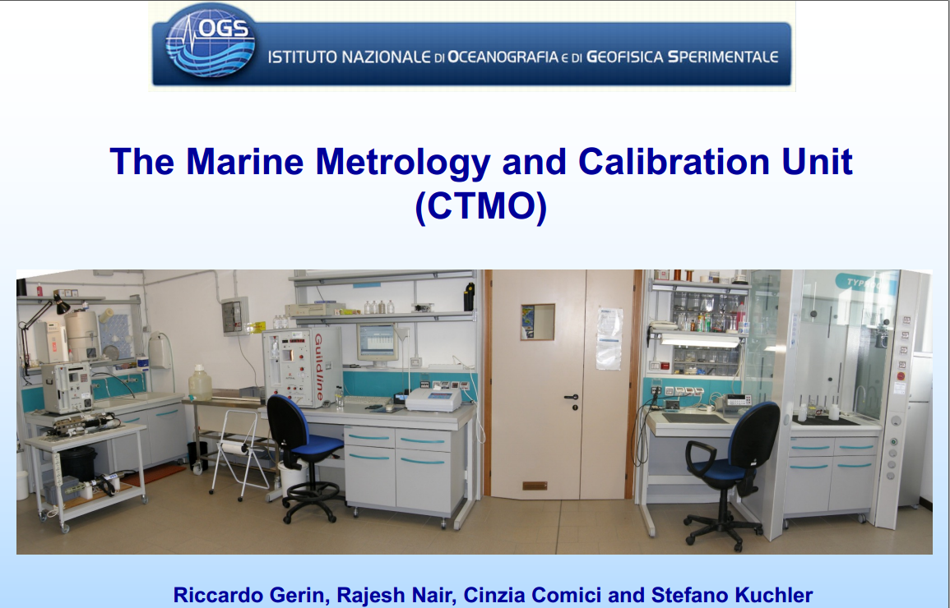
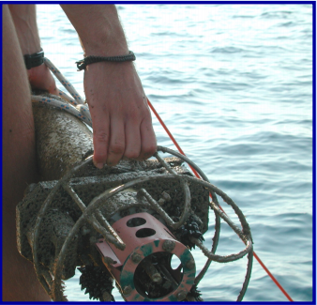
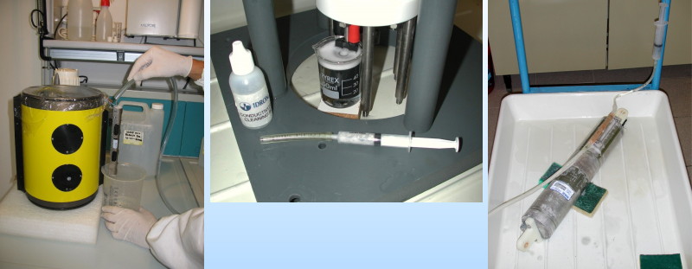
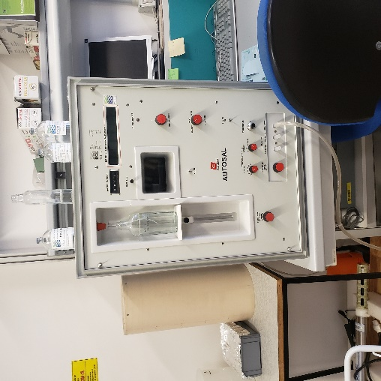
The Marine Metrology and Calibration Unit (CTMO)
The main aims of the CTO
Assure data quality,
Ensure the conformity of the characteristics
Evaluate and experiment new instrumentation
Simulate realistic field conditions and scenarios for testing instrumentation.
Maintenance procedures
Calibration procedures

Slide 8
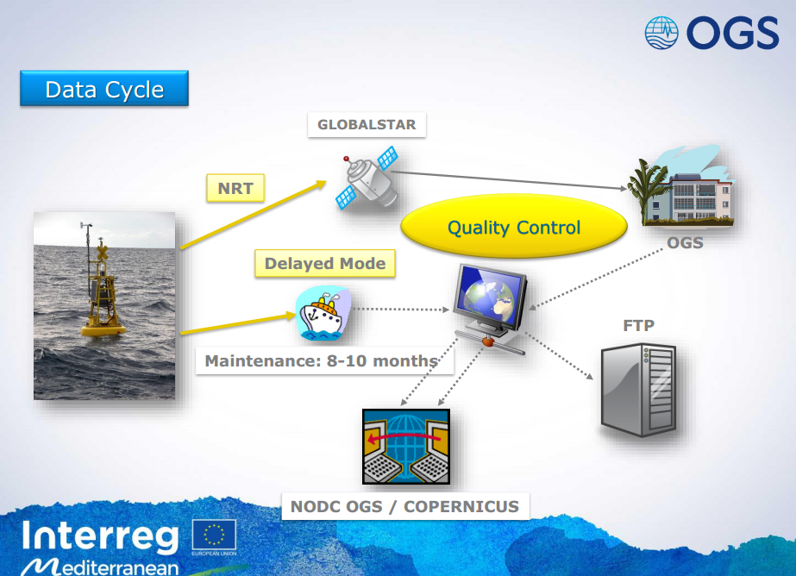
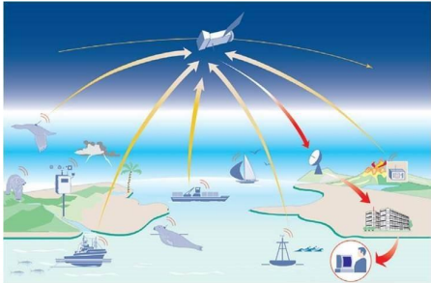
Transmission, download and data processing
Satellite
Radio
Mobile broadband
Undersea cable
Data transfer
Database & Metadata
Data accessibility
DATA MANAGEMENT
QUALITY CONTROL

Slide 9
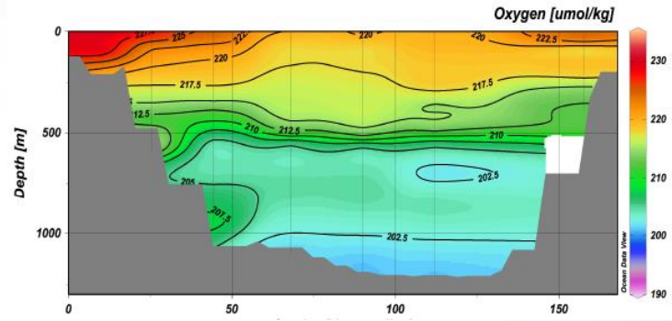
Hands-on Practice with webODV
Data visualization and data retrieval with webODV
• Presentation of webODV
• Example: Data visualization of dissolved oxygen along a transect
• Hands-On Practice: Data visualization of salinity along the transect

Slide 10

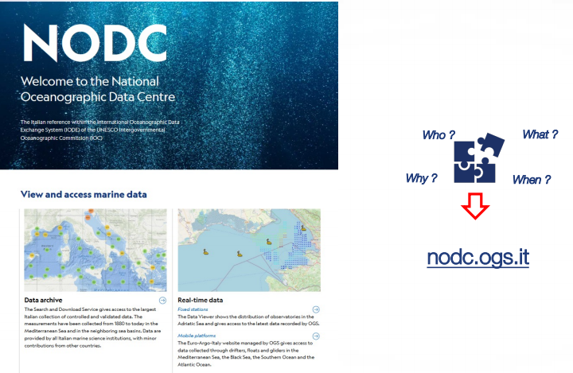
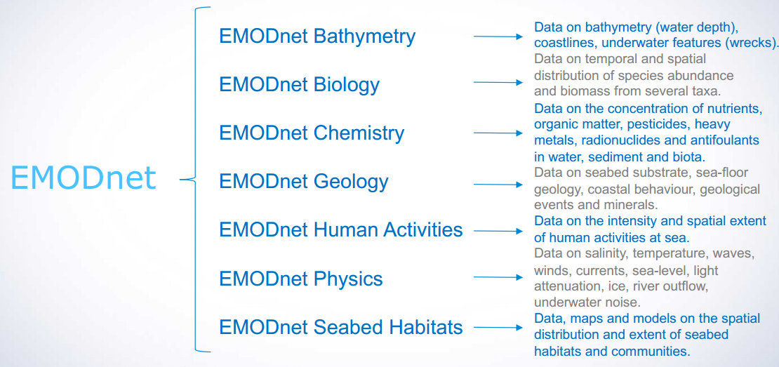
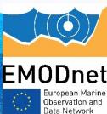
Short presentation of the National Oceanographic Data Centre (NODC) and the European Marine Observation and Data Network (EMODnet)

Slide 11
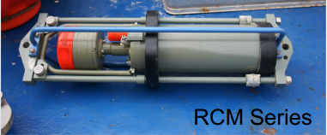
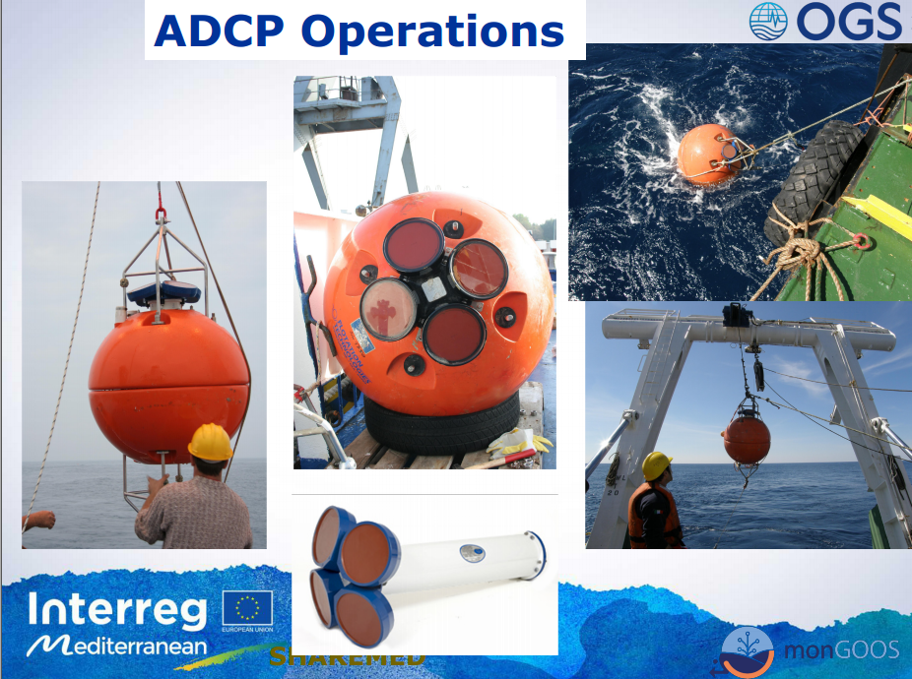
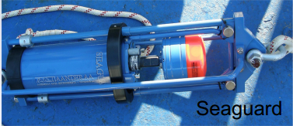
Current Measurements
Eulerian measurements (involve «fixed» point observation):
- Current-meter (punctual data)
- ADCP (Acoustic Doppler Current Profiler) (column data)
- ADCP-VM (ADCP Vessel Mounted)
Lagrangian measurements (involve a parcel of fluid as it moves):
Drifters (surface and sub-surface measurements)
Floats (profiling device- surface and parking depth currents)

Slide 12
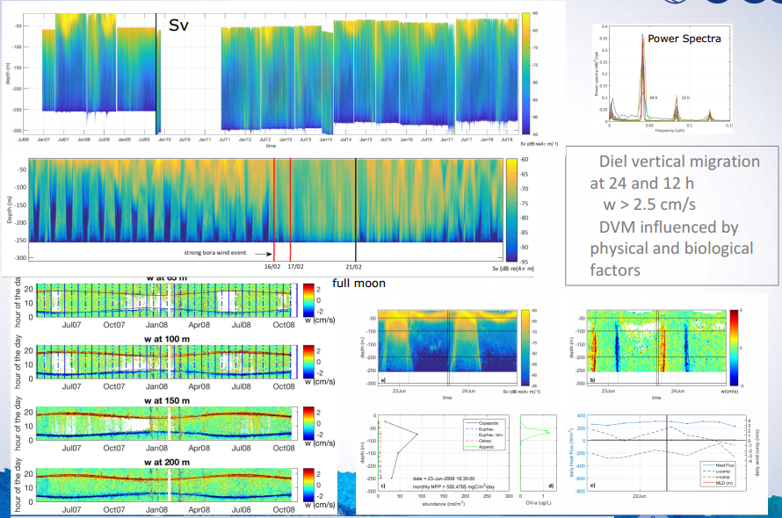
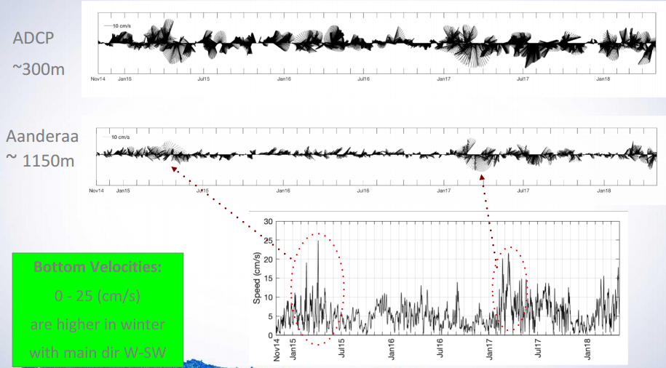
Data Processing
ADCP:
• Visualizing with WinADCP (or VMDAS)
• Performed also on punctual data (AD)
For both ADCP cells and current-meter time series:
• Spectral and harmonic analysis
• Low-pass filter with cut-off period at 33 hours

Slide 13
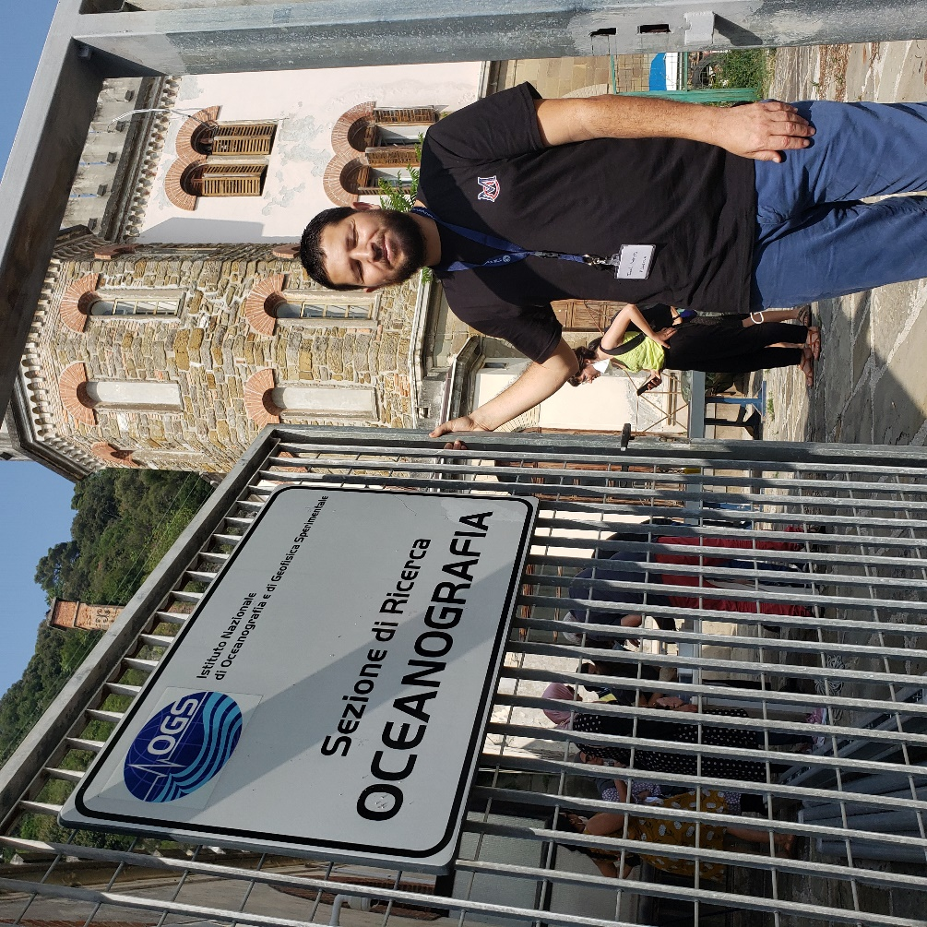
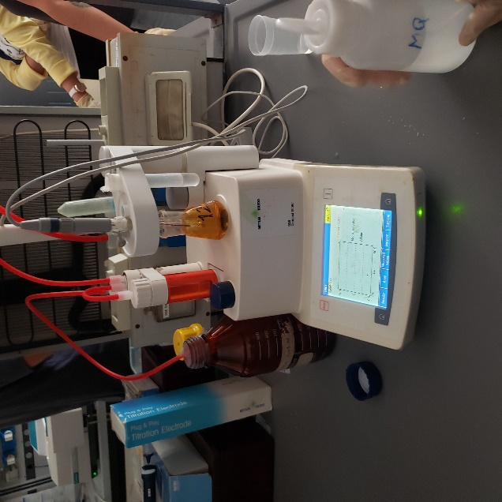
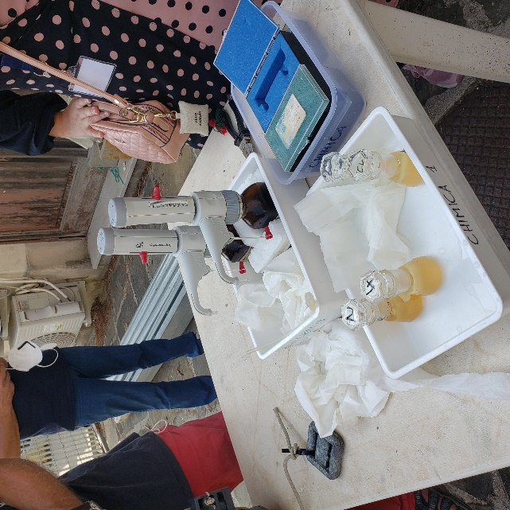
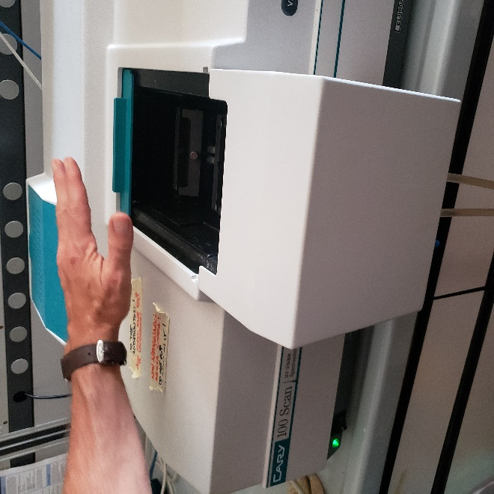
Visit of the oceanographic station
Water sampling by Niskin bottle
Analyze of Dissolved oxygen by Winkler method
Analyze of pH by Spectrphotometric method

Slide 14
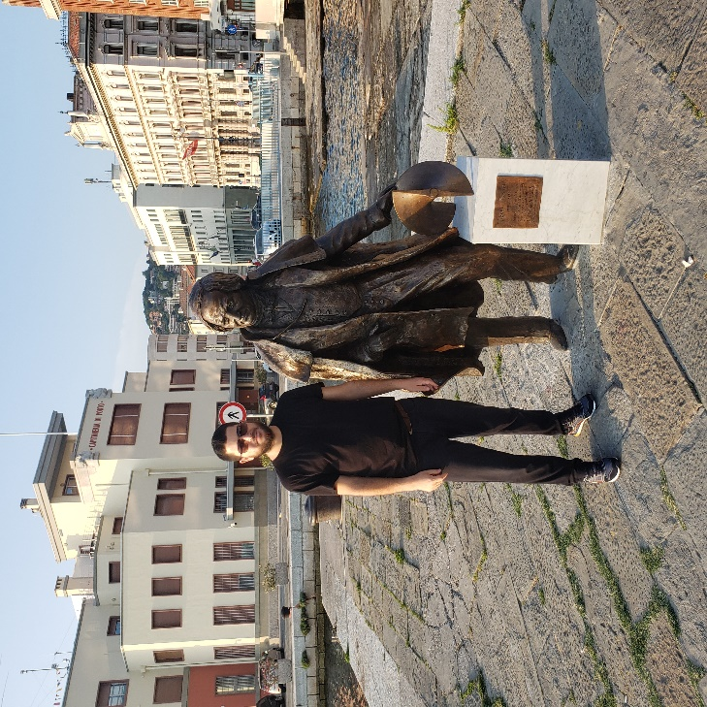
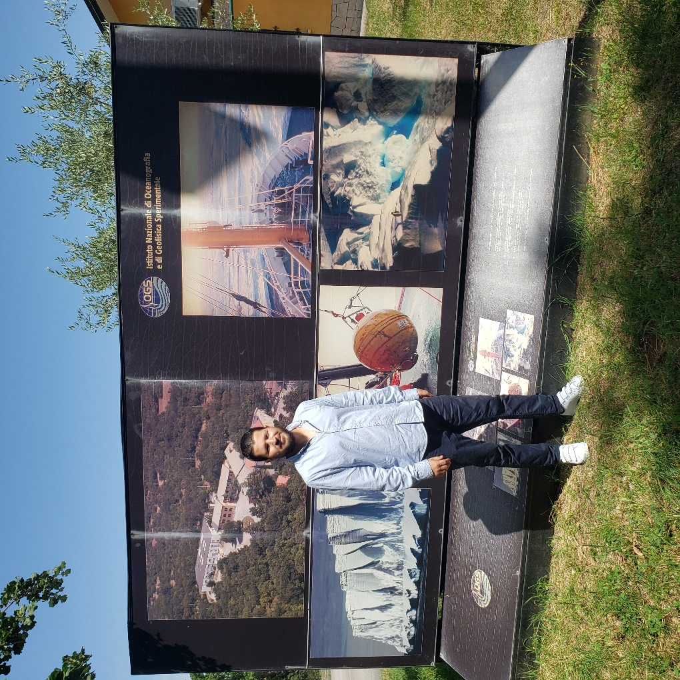
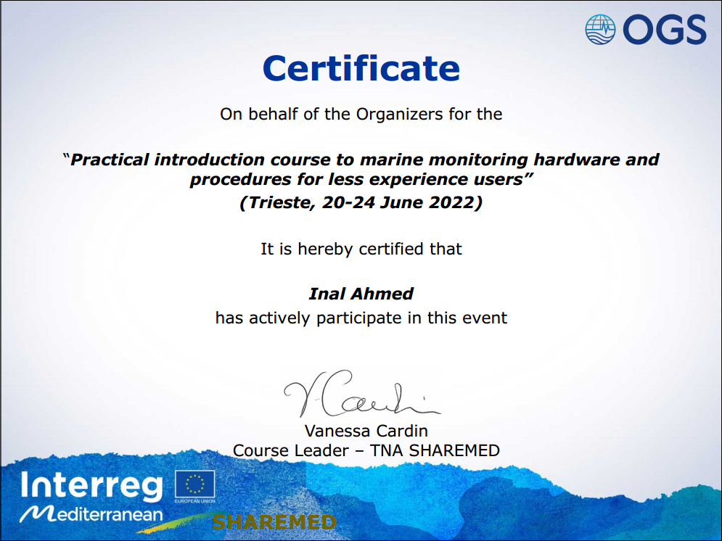

Slide 15
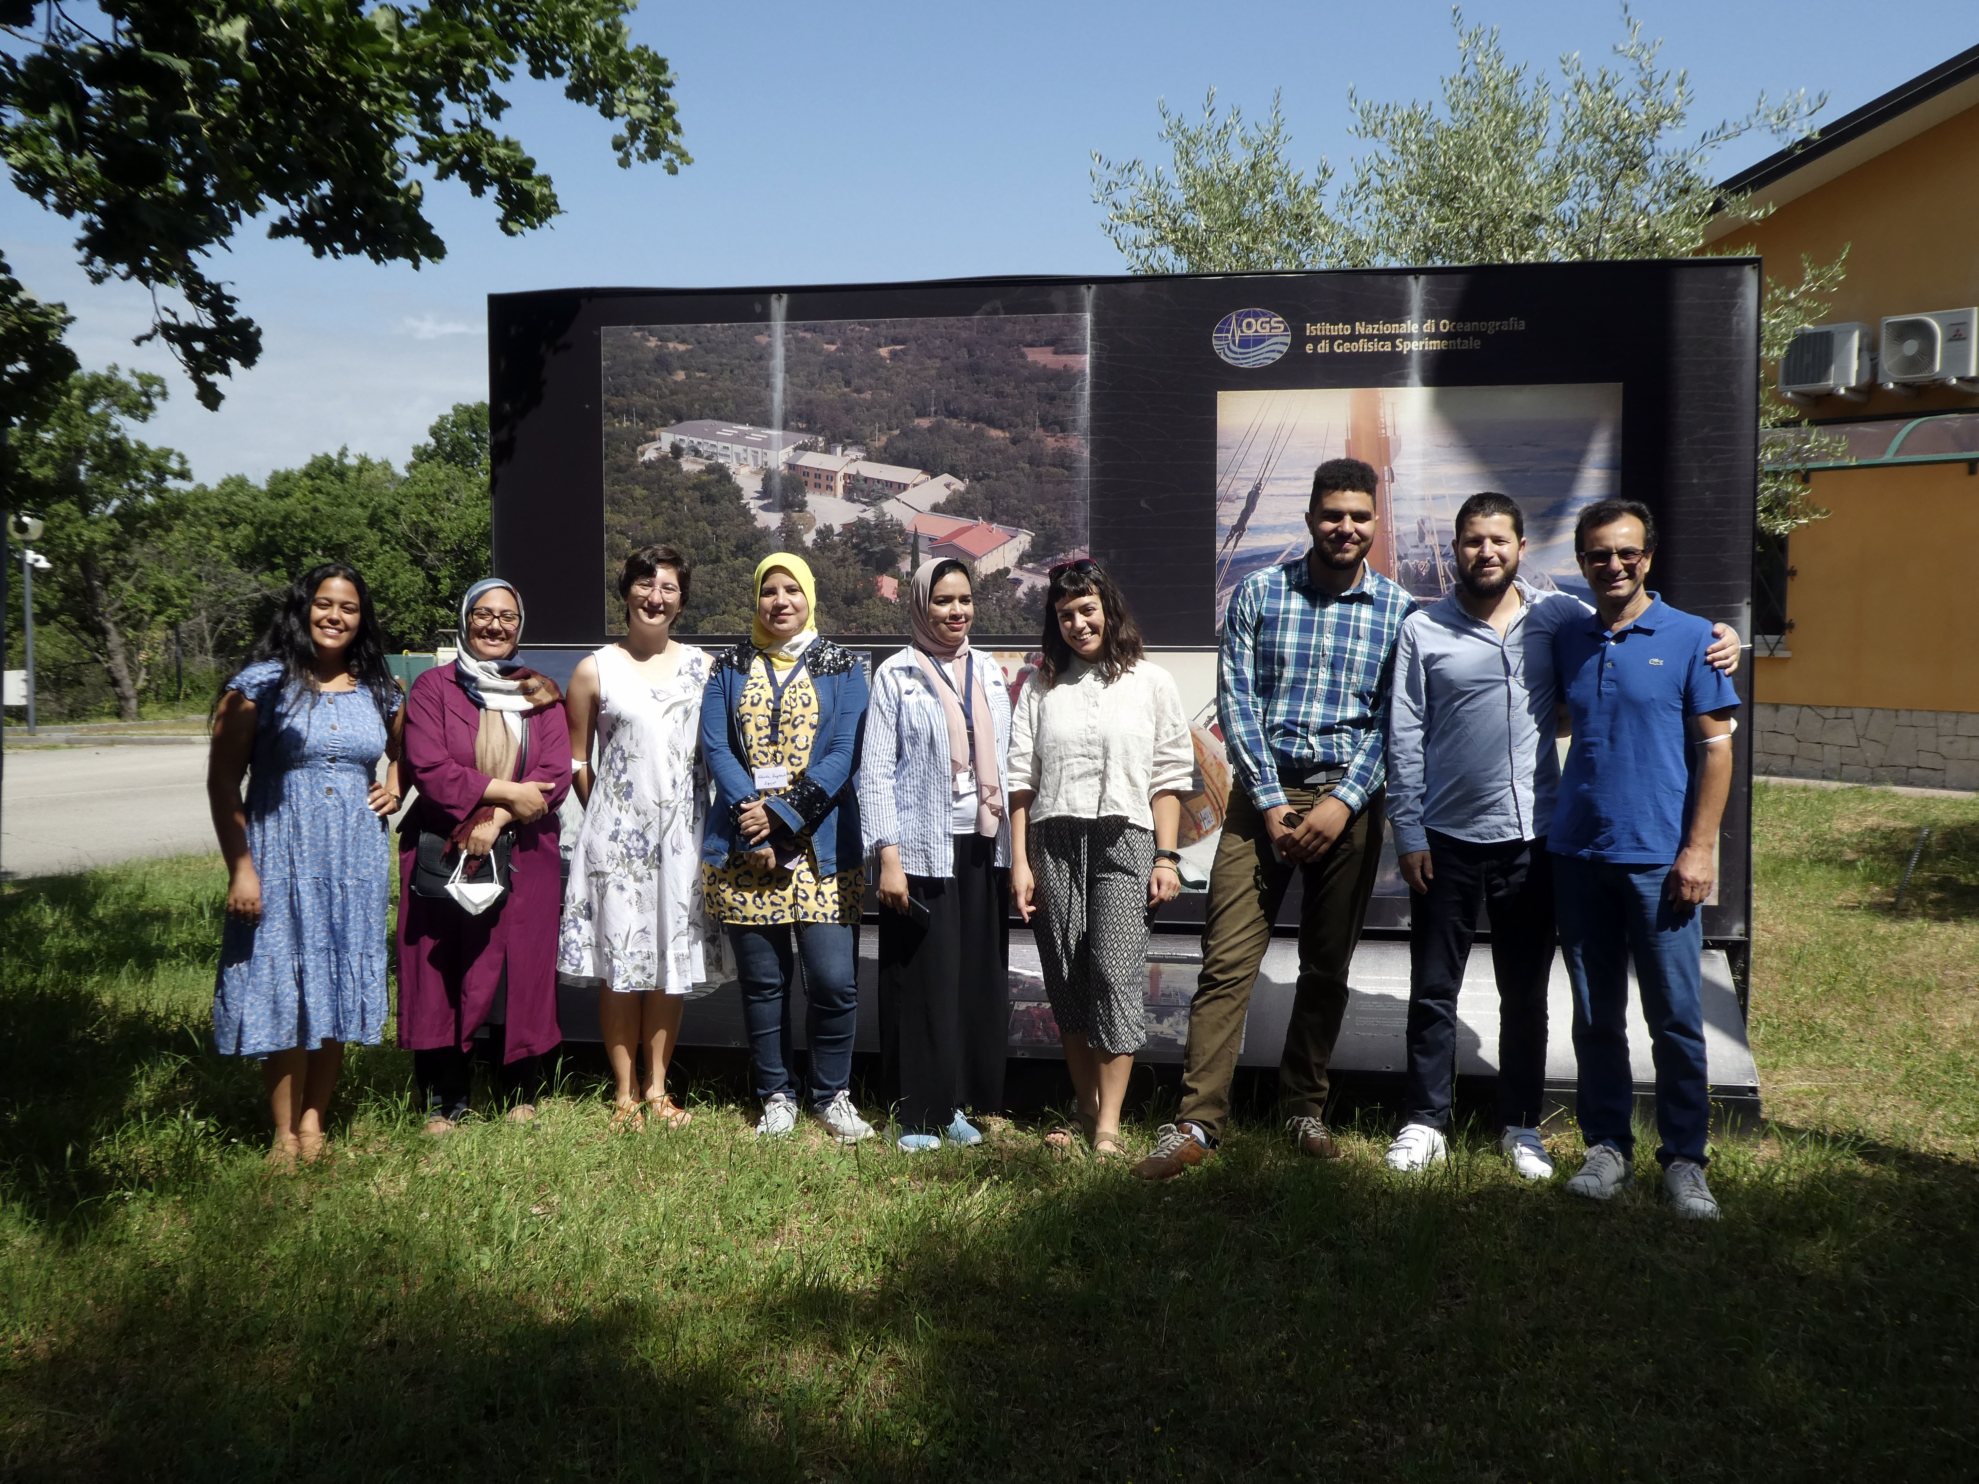

Slide 16
THANK YOU!
Ahmed INAL
CNRDPA
inal_ahmed@yahoo.fr
SHAREMED

